Slide 1



ANTHER & STIGMA
SMART FARMING
Dual-Robotic Arms
Muhammad Noor Sabri Bin Md Yusoff

Slide 2
PROBLEM STATEMENT
Conventional farming has proved to occupy large amount of space to compensate for the passages in order for the farmers to work on. This affects the overall annual yield of the crops. To overcome this issue, the unmanned dual-robotic arms will be deployed to exploit the maximum potential in the field.

Slide 3
OBJECTIVES
To optimise the space used for farming
To increase the productivity of cultivation
stonks

Slide 4
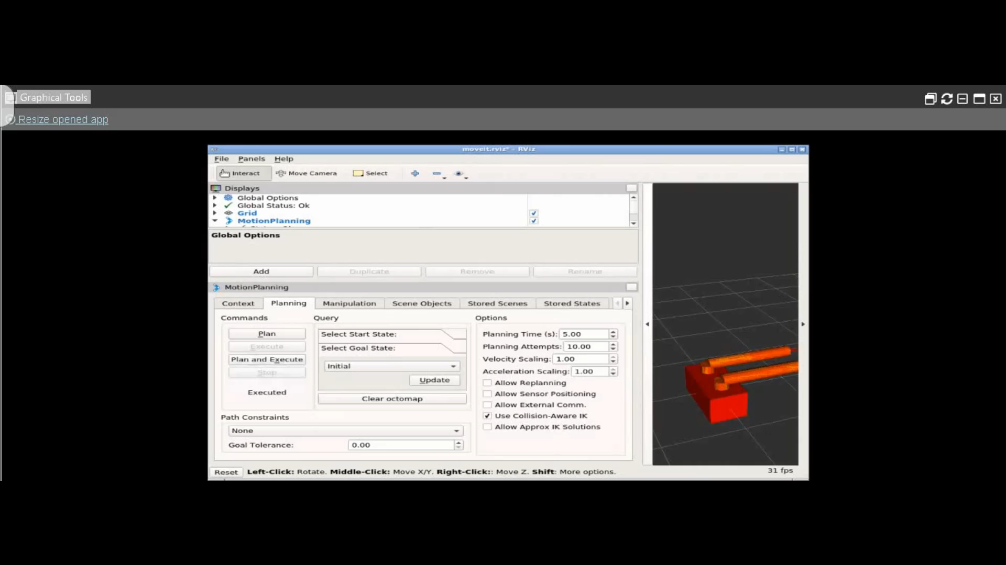
Simulation Video

Slide 5
Sustainability & Future work
We cannot deny the fact that robots are more efficient than humans making this project very sustainable.
Many things can be added to this project to make it more sustainable in the future.

